Slide 1
Practice Exam 3
MATH 1550 - Precalculus

Slide 2
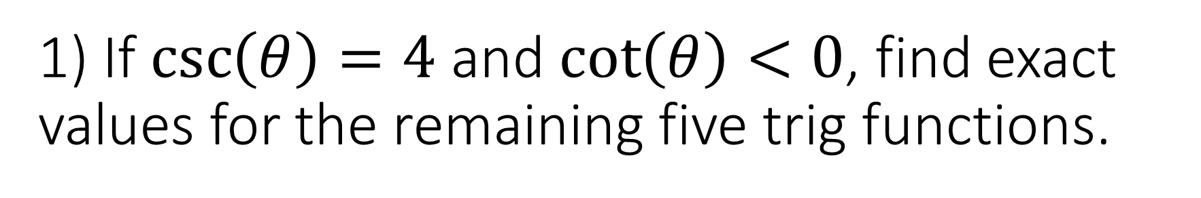
1) If $\csc\left(θ\right)=4$ and $\cot\left(θ\right)<0$, find exact values for the remaining five trig functions.

Slide 3
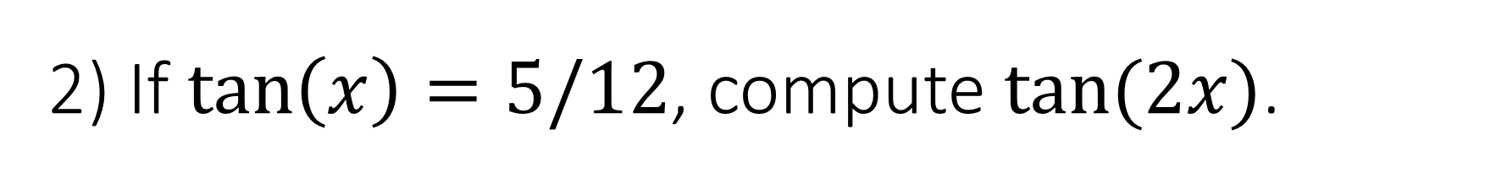
2) If $\tan\left(x\right)=5/12$, compute $tan⁡(2x)$.

Slide 4

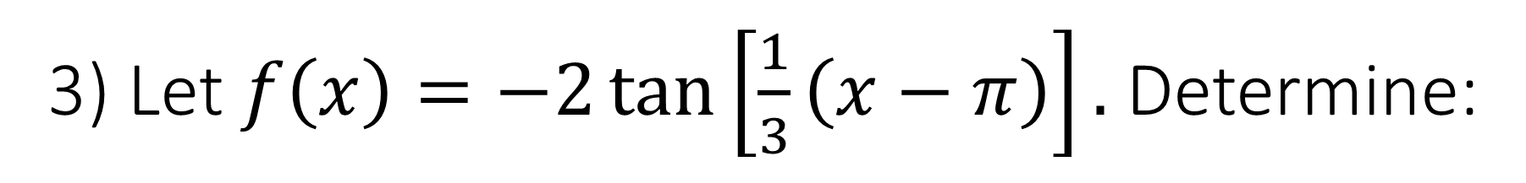
3) Let $f\left(x\right)=−2\tan\left[\frac{1}{3}\left(x−π\right)\right].$ Determine:
The amplitude of $f$;
The period of $f$;
The phase shift of $f$;
All intercepts of $f$.

Slide 5
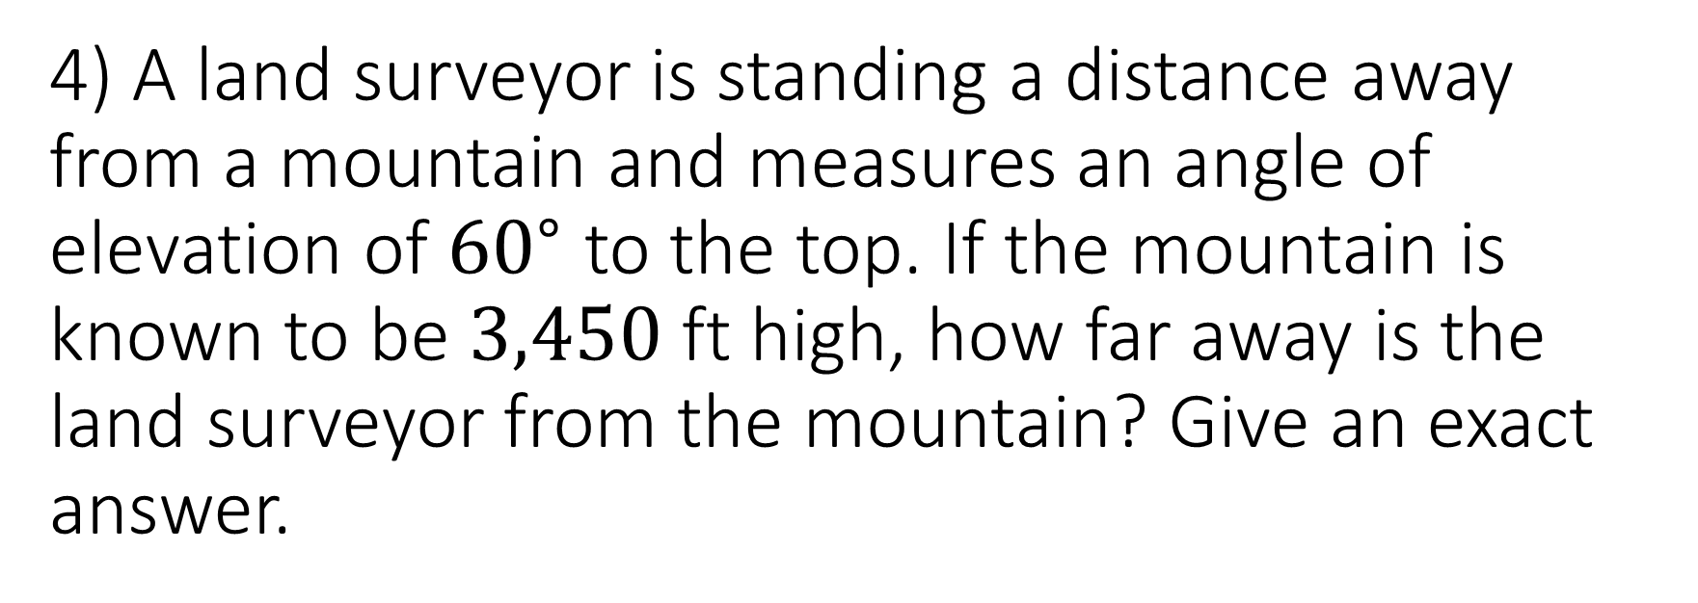
4) A land surveyor is standing a distance away from a mountain and measures an angle of elevation of ${60}^{∘}$ to the top. If the mountain is known to be $3,450$ ft high, how far away is the land surveyor from the mountain? Give an exact answer.

Slide 6
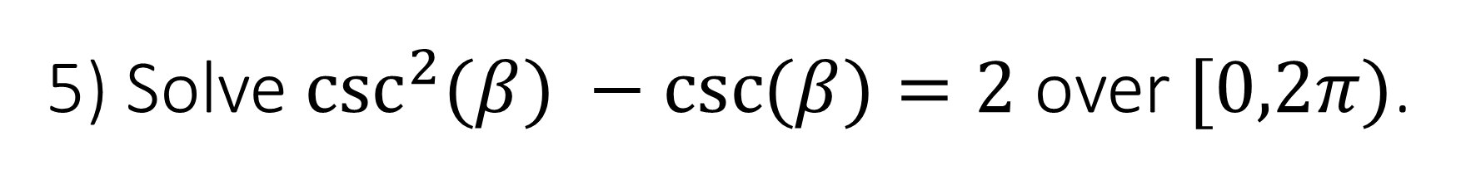
5) Solve $\csc^{2}{(β}) −\csc{(β})=2$ over $[0,2π)$.

Slide 7
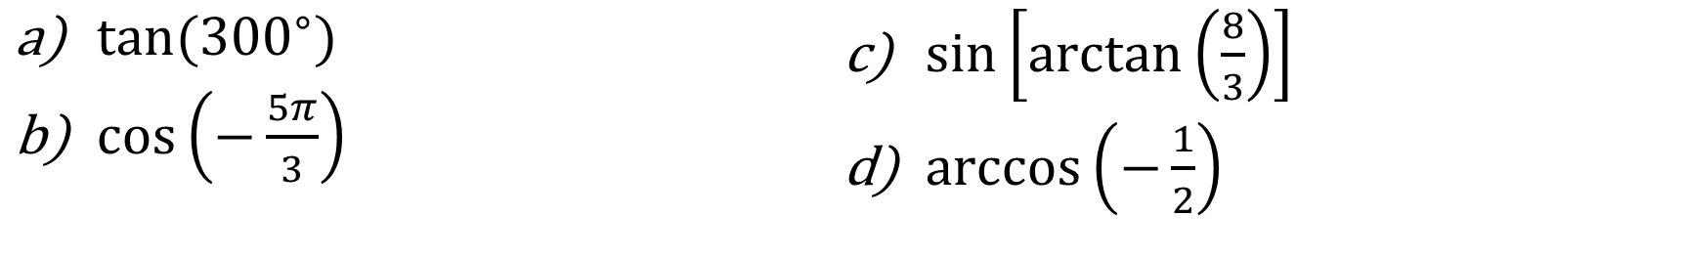
6) Evaluate each of the following exactly:
$\tan{({300}^{∘}})$
$\cos\left(−\frac{5π}{3}\right)$
$\sin\left[\arctan\left(\frac{8}{3}\right)\right]$
$\arccos\left(−\frac{1}{2}\right)$

Slide 8

7) Prove the trig identity:
$$\frac{\sin{(x)}+1−\cos^{2}{(x)}}{\cos^{2}{(x)}}=\frac{sin⁡(x)}{1−sin⁡(x)}$$

